Slide 1
UPM Update
WP2 Leader: UPM Team

Slide 2
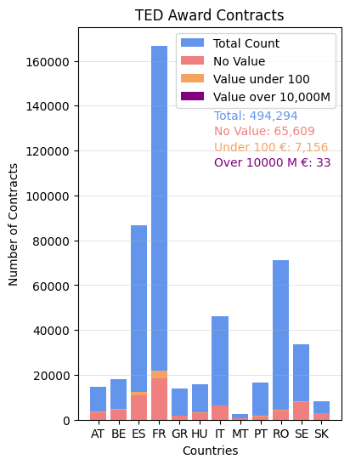

TED Award Values Analysis:
The objective of this analysis is an initial estimation of budgetary value available on TED’s Contract Award Notices.
The accuracy and completeness of the values is determined.
We are concerned with figures too low and too high to be realistic award values.
After cleaning those data, estimations for contracts with missing value must be considered.

Slide 3
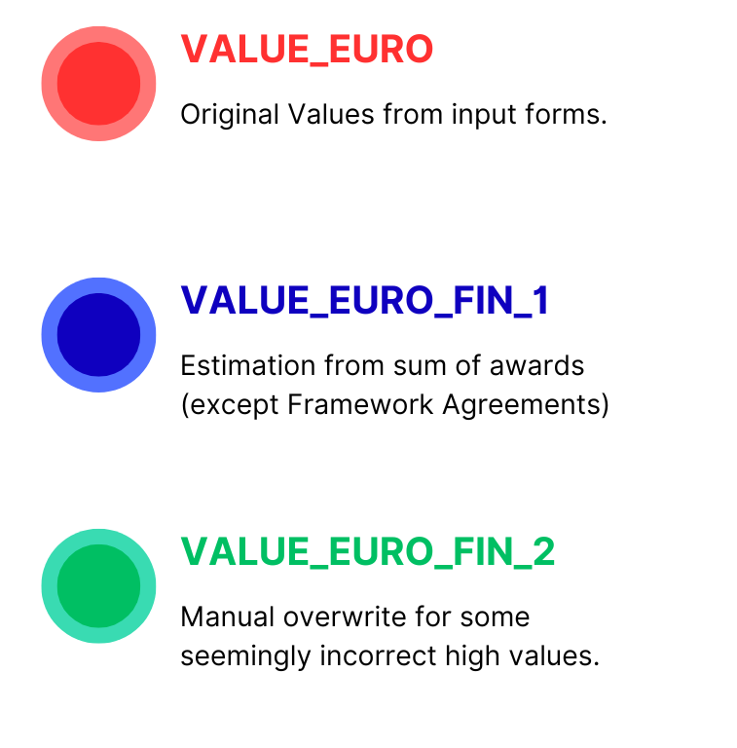
Available Estimations:
Variable | Total Count | <=100 Count | >=10,000M Count | No Value Count | Mean | Standard Deviation
VALUE_EURO | 1,171,413 | 100,084 | 109 | 183,343 | 310 M € | 52,588 M €
VALUE_EURO_FIN_1 | 1,174,223 | 105,517 | 79 | 180,533 | 278 M € | 50,757 M €
VALUE_EURO_FIN_2 | 1,174,223 | 105,896 | 31 | 180,533 | 84 M € | 27,762 M €
All TED Data
The data better fits a logarithmic scale due to its extensive range.
There are two available estimations from TED to serve as a starting point.
High-value contracts have an enormous leverage over the mean and std. Employing VALUE_EURO_FIN_2 has an impact in the core object of this study, bringing the figures closer to their real value.

Slide 4
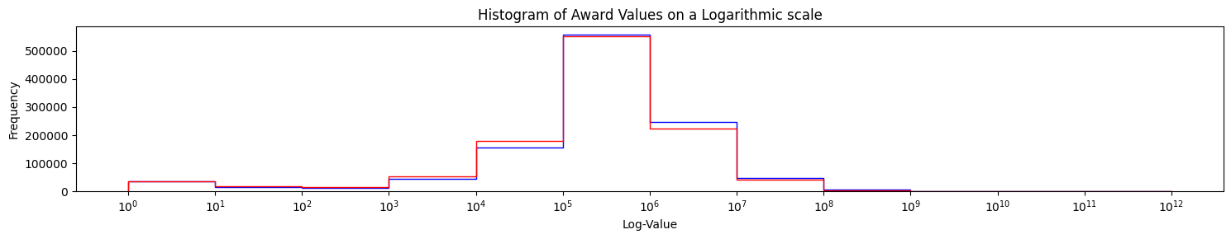
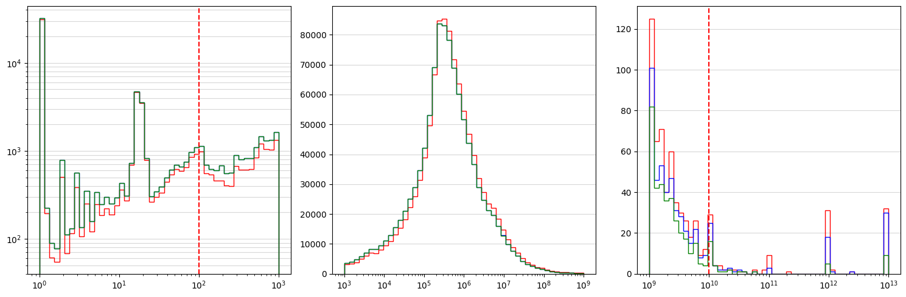
Exploratory analysis:
Many contracts with value 0.
Some contracts with very high values: They have high leverage over aggregations.
Available TED estimations alleviate this problem.
Non-trivial cut-off points for high values

Slide 5
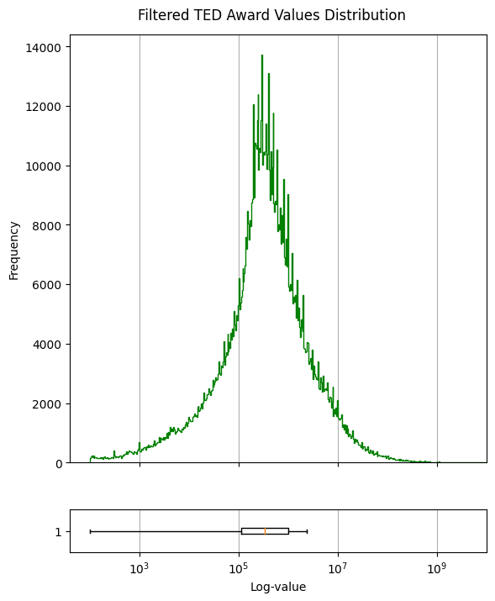
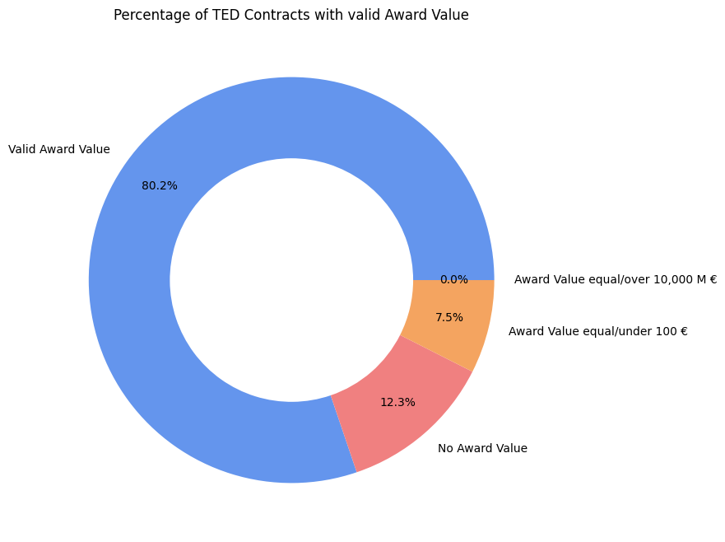
Data Cleaning:
We will use VALUE_EURO_FIN_2.
Filtering Contracts without value.
Filtering Values under and equal to 100 €.
Filtering values over and equal to 10,000 Million €.
We have lost 19.8% of contracts.
But there are good results for approximating a contract’s value.
For now, we can use the mean value.

Slide 6
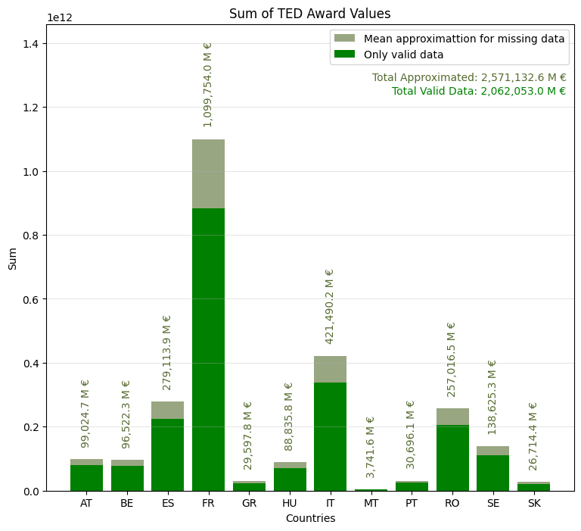

Preliminary results:
Country | Count | Sum | Mean | Standard Deviation
AT | 14,456 | 79,418 M € | 5 M € | 50 M €
BE | 17,557 | 77,411 M € | 4 M € | 42 M €
ES | 86,627 | 223,850 M € | 3 M € | 36 M €
FR | 163,030 | 882,005 M € | 5 M € | 111 M €
GR | 14,056 | 23,738 M € | 2 M € | 18 M €
HU | 15,901 | 71,246 M € | 4 M € | 34 M €
IT | 46,139 | 338,036 M € | 7 M € | 63 M €
MT | 2,410 | 3,001 M € | 1 M € | 5 M €
PT | 16,299 | 24,618 M € | 2 M € | 9 M €
RO | 70,712 | 206,128 M € | 3 M € | 23 M €
SE | 31,628 | 111,178 M € | 4 M € | 19 M €
SK | 8,117 | 21,425 M € | 3 M € | 12 M €
Only Valid Data

